Slide 1
IMAGE STEGANOGRAPHY

Slide 2
Information Hiding -Introduction
Purpose:
Hiding sensitive information vital for security purposes
Securing private files and documents
Hiding information - 3methods - Cryptography, Steganography, Watermarking.
Cryptography - Data to be hidden is coded
several techniques ; sophisticated
visually obvious to be encrypted; appears non-sensical
Watermarking
Applies a copyright label ; prevents illegal use of content
Improper removal causes degradation of original information
Steganography -hiding information by using another information as a cover.
Elements:
cover component, message component, stego component.

Slide 3
Image steganography
Initially used in images sent through emails.
Presence detected by huge size of the stego-images.
Various techniques available:
LSB substitution method
Blocking method
Palette modification method
LSB technique can be used for BMP(bitmap) images.
Blocking method – DCT and DWT – used for JPEG images
Palette based method – used for GIF images.

Slide 4
Methods:
LSB substitution method:
Deals with substituting LSB bits of corresponding pixels in image to store the text message or another image as a message.
Block method:
blocks of the image are considered and DCT (discrete cosine transform) is done in order to break them.
Each block is then subdivided into 64 parts (DCT coefficients).
These coefficients are modified i.e. the color gets modified a little by storing some text or another image in it.
Palette modification:
Every image uses a set of color values.
Palette Modification replaces the unused colors within an image’s color palette with colors that represent the hidden message.

Slide 5
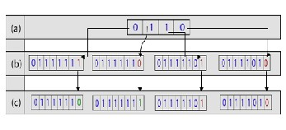
LSB substitution method -Algorithm:
In the current project, emphasis is given to this
method.
Simplicity
Mostly Imperceivable
One of the channels among RGB can be chosen, and LSB of its pixels altered or all the channels could be used.
Example:
(a) binary form of message to be hidden
(b) few pixel values on cover image
(c) LSB altered

Slide 6
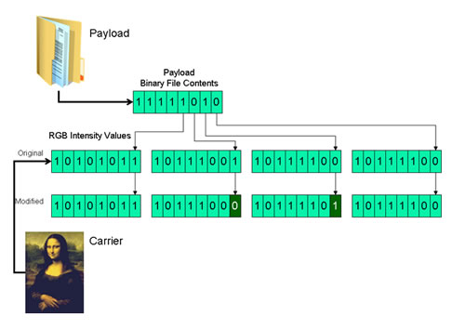
Algorithm:
Input the message to be hidden. (either image or text)
Check the maximum number of bits that can be accepted by the cover image
Replace the LSB bits of the pixels in cover image with the binary representation of the message. => we obtain Stego image
Either color image (RGB) or grayscale image can be used as a cover image.
In case of color image, 24bit image i.e. 8bits are present for each for RGB so more number information pixels can be stored.
Modification can be done to either just the last 1 bit or 2,4 or more bits depending on requirement.

Slide 7

Generally ideal to replace only about half of the pixels with the message in order to keep the stego image visually good.
To retrieve the original image,
Number of bits used to store the secret image should be known.
The host image is scanned, to pick out the least significant bits according the number used
These are then used to create a new image such that the LSB bits extracted now become the most significant bits in the retrieved image.

Slide 8
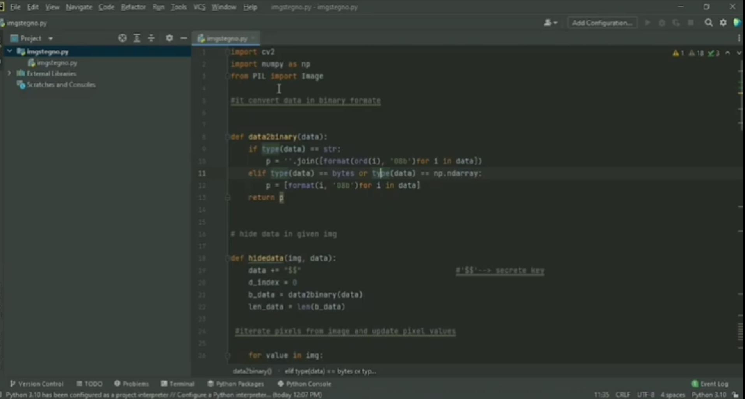
Implementation of project

Slide 9
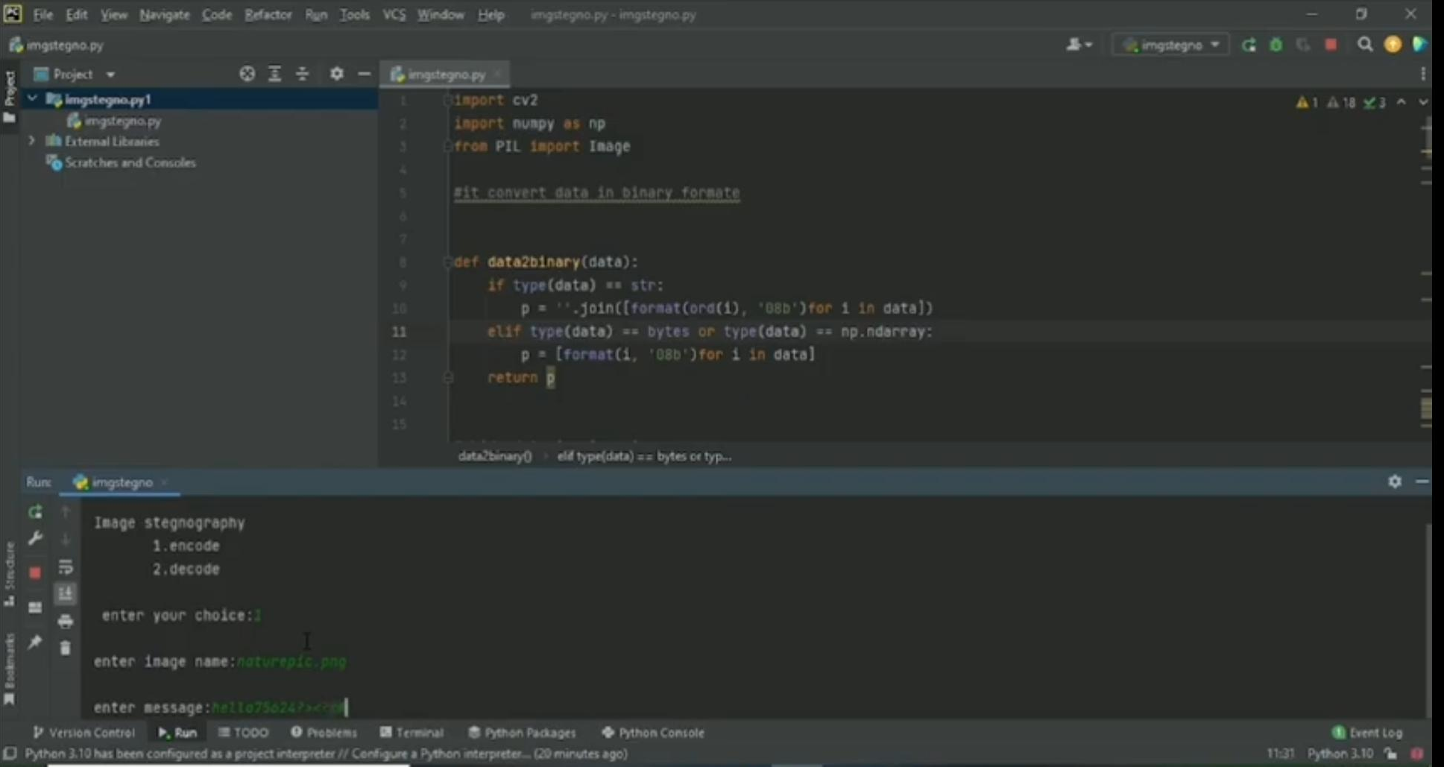

Slide 10
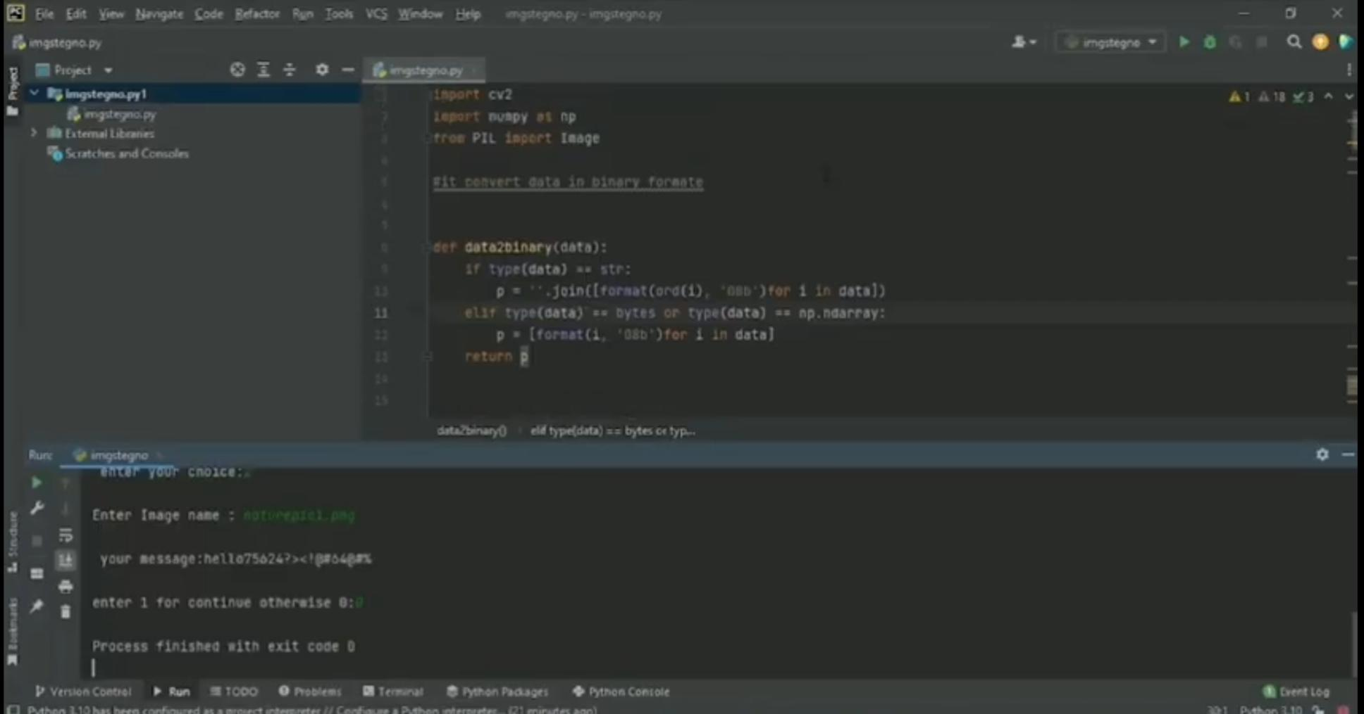

Slide 11
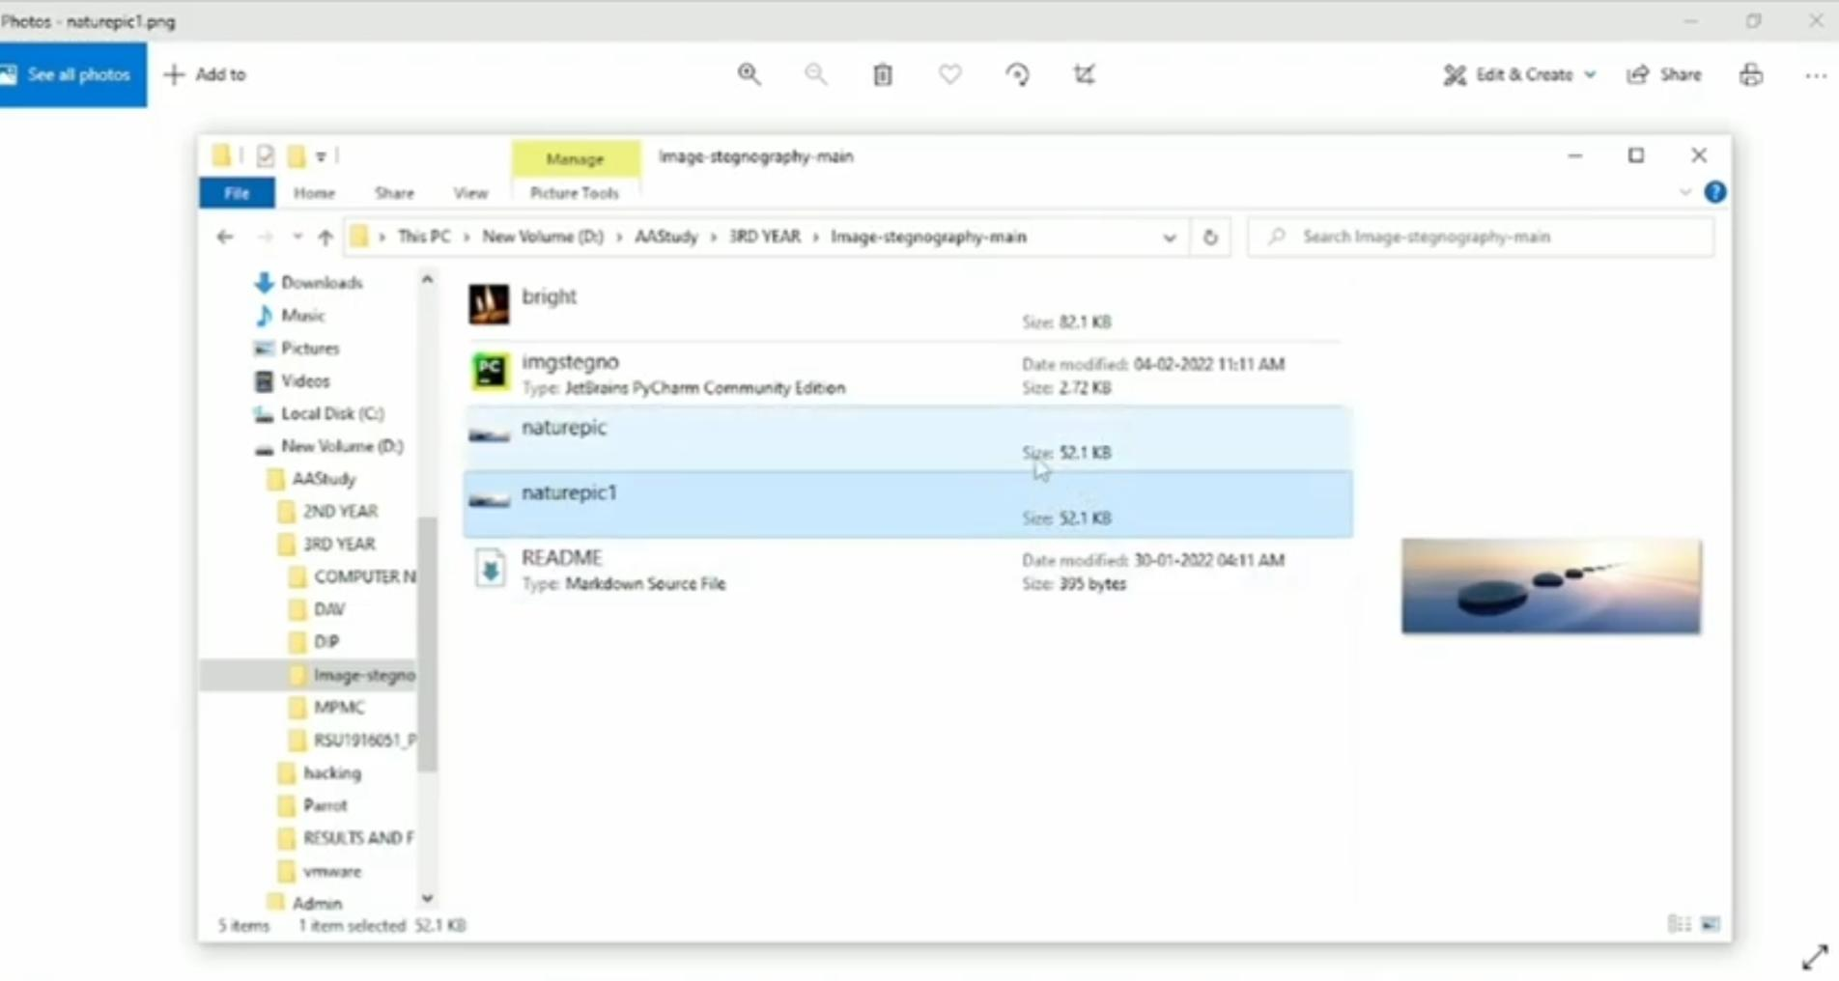

Slide 12
THANK YOU

